Slide 1
Air and Noise Pollution Detection System

Slide 2
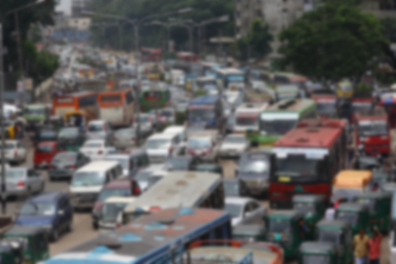
Microprocessor And Microcontroller Lab
CSE 3118
Proposal Presentation
Ms. Lomat Haider Chowdhury
Lecturer (Grade-I),Department of CSE, AUST
Ms. Sumaiya Nuha Mustafina
Lecturer (Grade-I),Department of CSE, AUST
Proposed TO:
Ms. Lomat Haider Chowdhury
Lecturer (Grade-I),AUST CSE
Ms. Sumaiya Nuha Mustafina
Lecturer (Grade-I) , AUST CSE
Proposed By:
Tasfia Jannat 20220104026
Khalid Ratin 20220104027
Ahnaf Amer 20220104040
Lamisa Zimy 20220104051

Slide 3

Contents
1
Main Concept
2
Required Components
3
Multidisciplinary
4
Design Data Sheet
5
Estimated Budget
6
Environmental , Social and Economic Impacts

Slide 4
Concepts
Internalized Monitoring Between Sensors to detect pollution levels and predict patterns.
Selective Alerting System triggered only when pollution exceeds threshold levels.
Reduced Noise Air from Unnecessary Warnings.
Maintaining Eco-Safety Norms.
1

Slide 5
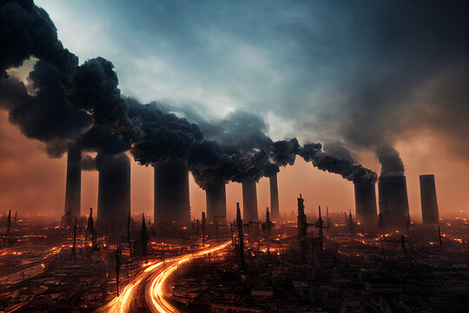
2

Slide 6
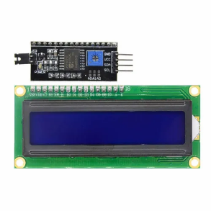
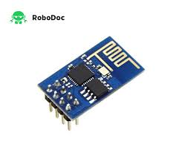
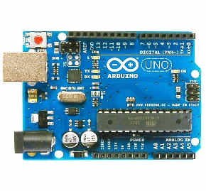
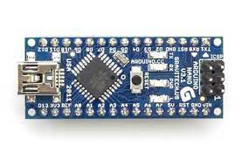
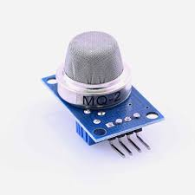
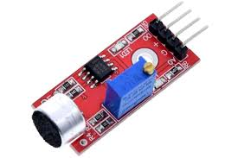
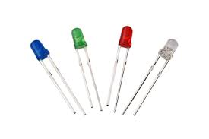
Equipment And Modern Tools
Arduino Boards
16X2 Serial LCD Modules
Esp 8266
MQ-135 Gas Sensor
LM-393 Sound Sensor
LED Light
3

Slide 7


Multidisciplinary Contribution
Electrical and Electronic Concepts:
Maintenance of voltage and current flows
Compatible electronics
Softwares:
Arduino IDE
Blynk IoT App
Programming languages: Arduino language
4

Slide 8
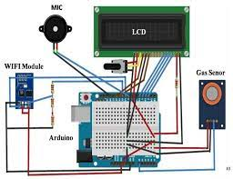
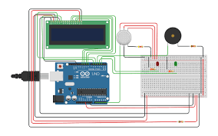
Design Data Sheet(Previous)
5

Slide 9
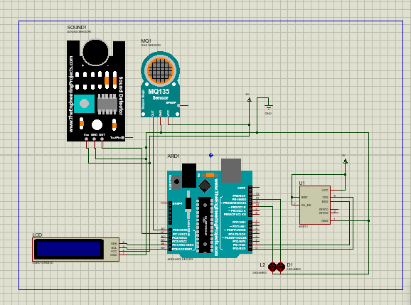
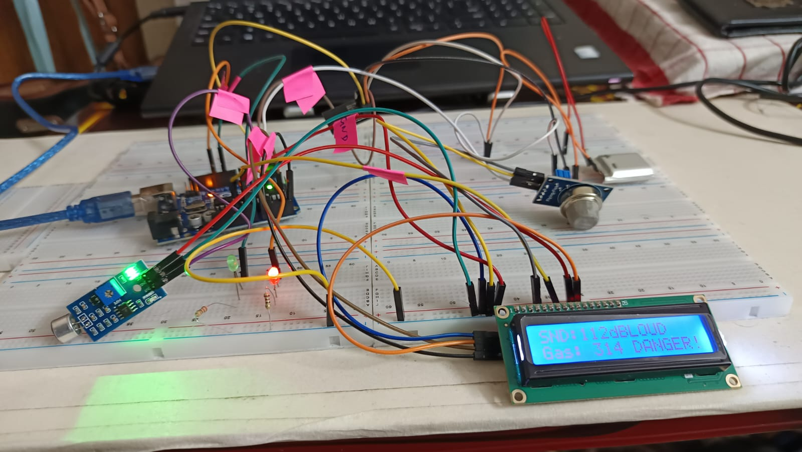
Design Data Sheet(Final)
Proteus Design
Final Project Picture
6

Slide 10
Estimated Budget
Components | Price | Quantity
Wires | 120 | 12pieces
Breadboard | 120 | 1pieces
ESP 8266 Wi-fi Module | 420 | 1pieces
Sound Sensor LM-393 | 170 | 1pieces
Gas Sensor MQ-2 | 150 | 1pieces
Arduino Uno | 700 | 1pieces
Led Lights | 20 | 4pieces
LCD 16x2 Display | 240 | 1pieces
7
Total Budget : 1970 TK (Approximate)

Slide 11
Final Budget
Components | Price | Quantity
Jumper Wires 3.7V li-ion Battery | 120 300 | 12pieces 1Pieces
Breadboard Arduino UNO(x1) | 150 700 | 1pieces 1pieces
ESP-01 8266 Wi-fi Module | 200 | 1pieces
Sound Sensor LM-393 | 170 | 1pieces
GasSensor MQ-135 | 170 | 1pieces
Arduino Uno | 700 | 1pieces
Led Lights | 20 | 4pieces
16x2 Serial LCD module | 240 | 1pieces
8
Total Budget : 2720 TK (Approximate)

Slide 12
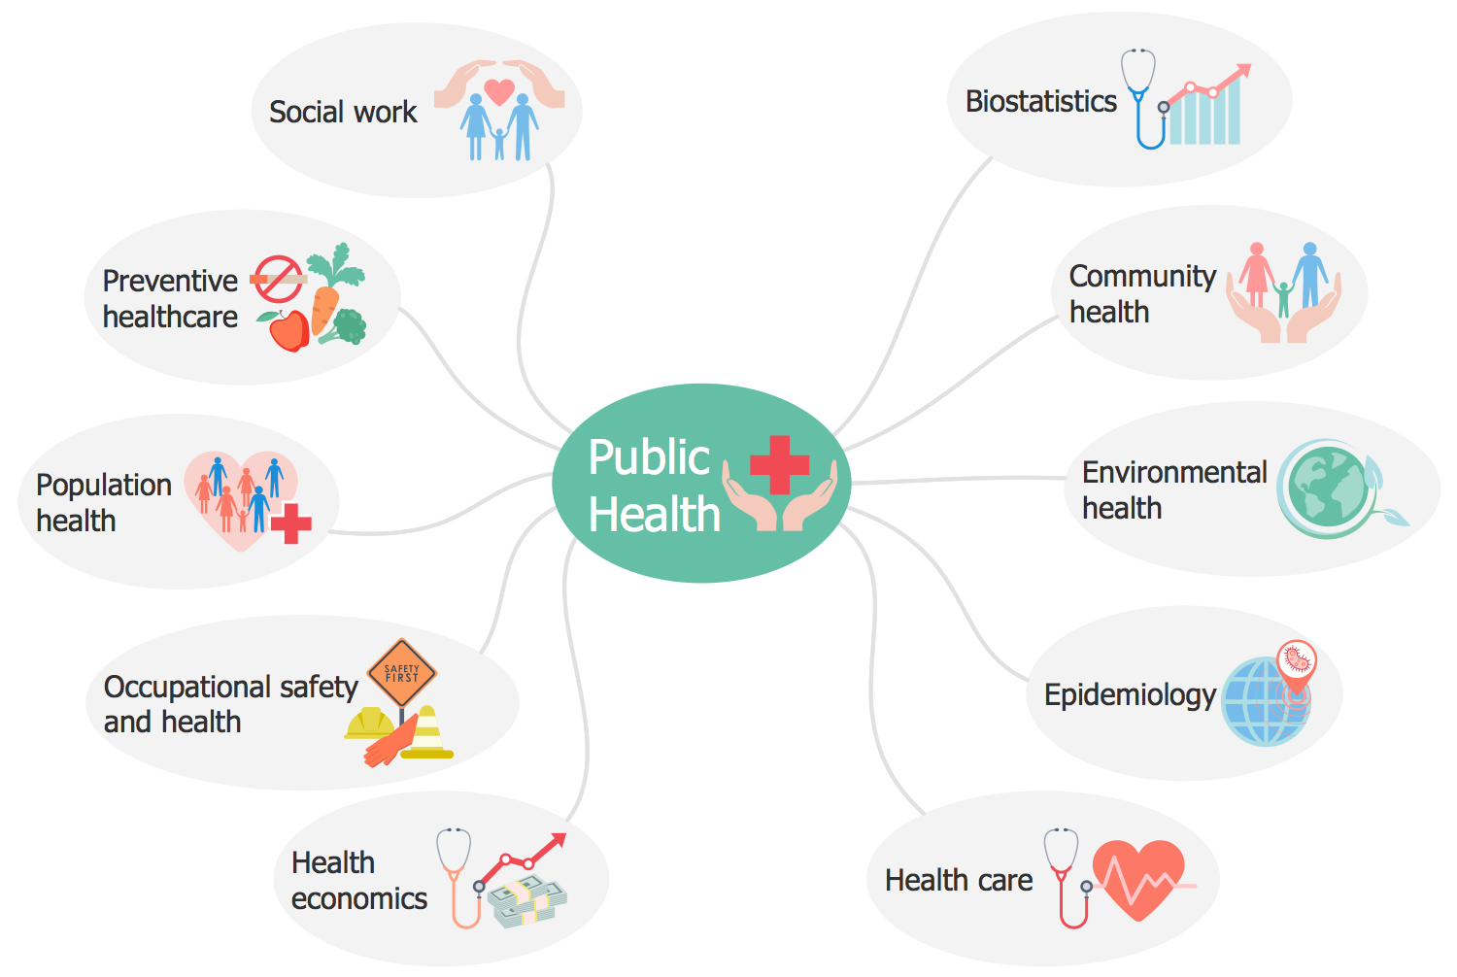
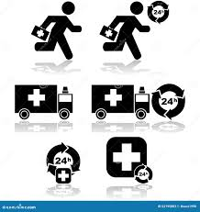
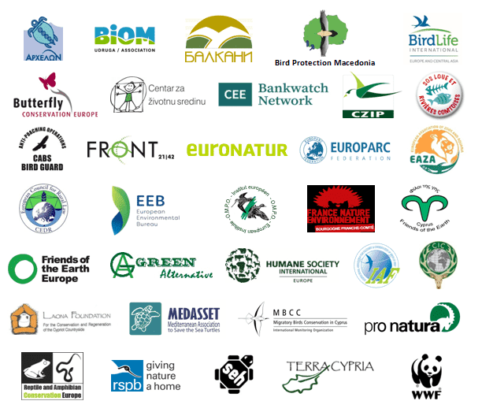
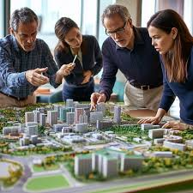
MULTIPLE STAKEHOLDERS
Environmental Agencies
Urban Planners
Public Health Organizations
Emergency Services
9

Slide 13
Impacts
Environmental Impacts
Promotion of Sustainable Practices
Conservation of Ecosystems
Climate Change Mitigation
Awareness of Environmental Issues
Long-Term Resource Sustainability
Reduction in Pollution Levels
10

Slide 14
Social Impacts
Reduction of Air & Noise Pollution Exposure
Improved Public Health
More Awareness & Responsible Behavior
Enhanced Quality of Life
Smart City Integration
Efficient Urban Planning
11

Slide 15
Economic Impacts
Cost-Effective Monitoring Systems with Advanced Features.
Job Creation in Environmental Tech & Engineering.
Collaboration with Industries & Government Bodies.
Expanding Market for Multidisciplinary Innovations.
12

Slide 16
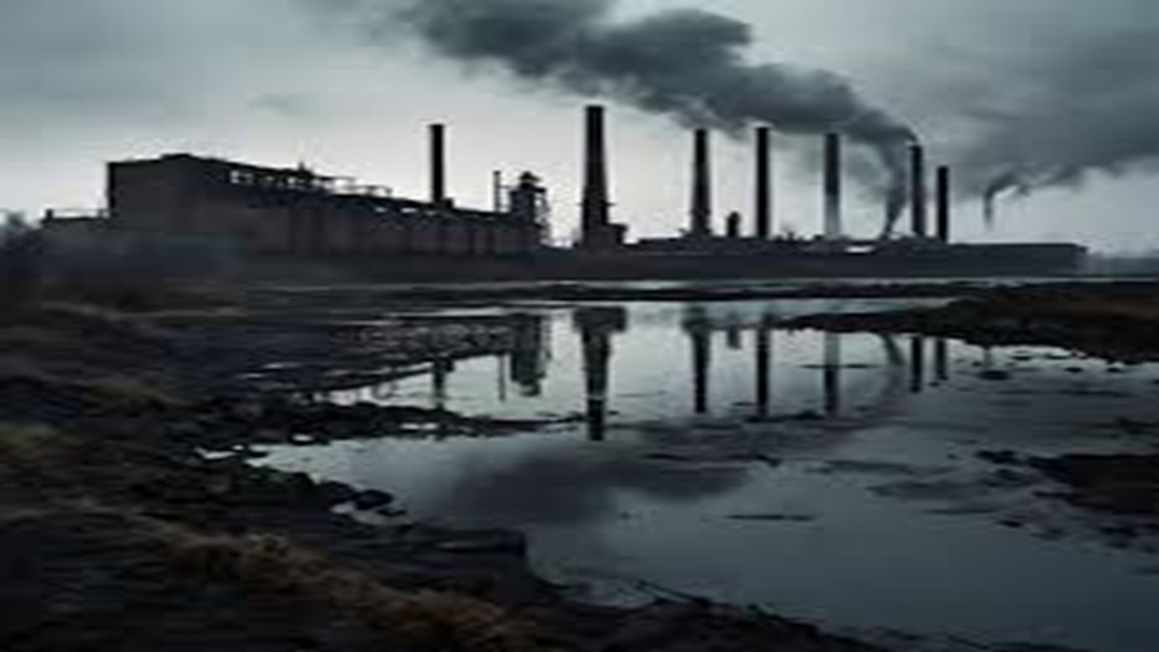
Thank You
Any Questions?

